Slide 1
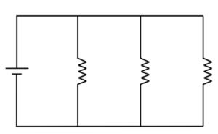
Parallel Circuit Resistance
R1=7Ω
R2=15Ω
R3=12Ω
20 V
A parallel circuit has two or more paths for current to flow through. Voltage is the same across each component of the parallel circuit. The sum of the currents through each path is equal to the total current that flows from the source.

Slide 2
Parallel Circuit Resistance
R1=7Ω
R2=15Ω
R3=12Ω
20 V
What is the total voltage gain in the circuit ?
What is the equivalent resistance of the circuit ?
What is the total current through the circuit ?
What is the voltage drop across each resistance ?
What is the current through each resistance ?

Slide 3
Parallel Circuit Resistance
What is the total voltage gain in the circuit ?
R1=7Ω
R2=15Ω
R3=12Ω
V=20
Total voltage gain
V_{T}= 20 V

Slide 4
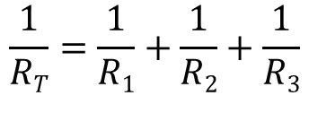
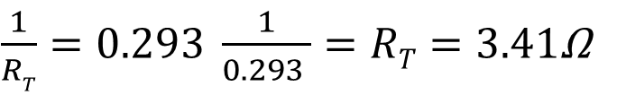
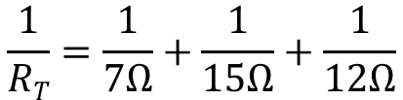
Parallel Circuit Resistance
2. What is the equivalent resistance of the circuit ?
R1=7Ω
R2=15Ω
R3=12Ω
V=20
Equivalent resistance
$$\frac{1}{RT}=\frac{1}{R1}+\frac{1}{R2}+\frac{1}{R3}$$
$$\frac{1}{RT}=\frac{1}{7Ω}+\frac{1}{15Ω}+\frac{1}{12Ω}$$
$\frac{1}{RT}=0.293 \frac{1}{0.293 }=RT=3.41$Ω

Slide 5
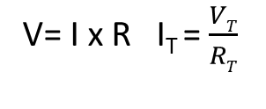

Parallel Circuit Resistance
3.What is the total current through the circuit ?
R1=7Ω
R2=15Ω
R3=12Ω
V=20
Total Current
V= I x R I_{T} = $\frac{VT}{RT}$
I_{T}$=\frac{20V}{3.41Ω}=5.87 A$

Slide 6
Parallel Circuit Resistance
4. What is the voltage drop across each resistance ?
R1=7Ω
R2=15Ω
R3=12Ω
V=20
Voltage Drop
V_{T}= V₁= V₂= V₃
V₁ = V_{T} = 20V
V₂ = V_{T} = 20V
V₃ = V_{T} = 20V

Slide 7



Parallel Circuit Resistance
5. What is the current through each resistance ?
R1=7Ω
R2=15Ω
R3=12Ω
VT = 20 v
RT= 3.41 Ω
IT= 5.87 A
V=20
Current through each resistance
I_{T}= I₁ + I₂ + I₃
I₁ $=\frac{V1}{R1}=\frac{20V}{7Ω}=2.86 A$
I₂ $=\frac{V2}{R2}=\frac{20V}{15Ω}=1.34 A$
I₃ $=\frac{V3}{R3}=\frac{20V}{12Ω}=1.67 A$

